Slide 1






IMDB TOP 1000 DATASET
PRESENTED BY:
JYOTI RANJAN SAHOO
GUIDED BY:
MRS.DR RITU MAITY

Slide 2

CONTENTS -:
ABOUT THE DATASET
IMPORTING THE DATASET INTO JUPYTER NOTEBOOK
DATA CLEANING
DATA VISUALIZATION USING MATPLOTLIB AND SEABORN
DIVIDING THE DATASET INTO INPUT AND OUTPUT FOR PREDICTION
SELECTING MODEL-CLASSIFICATION/REGRESSION
APPLYING EQUIVALENT CLASSIFICATION TECHNIQUES FOR APPROPRIATE PREDICTION
LABEL ENCODING FOR ALL THE STRING COLUMNS
CALCULATING R2 SCORE AND MEAN SQUARED ERROR
CREATING INTERACTIVE DASHBOARD IN MS EXCEL USING PIVOT TABLES AND GRAPHS
CREATING INTERACTIVEDASHBORD IN TABLEU 2019 CRACK VERSION
CONCLUSION

Slide 3
ABOUT THE DATASET-:
This dataset contains information about the top 1000 movies and TV shows as listed on IMDb. The key attributes include:
Poster_Link: URL to the movie or TV show's poster.
Series_Title: Name of the movie or TV show.
Released_Year: The year the movie or TV show was released.
Certificate: Age certification for the movie or TV show.
Runtime: Total runtime in minutes.
Genre: Genre classification of the movie or TV show.
IMDB_Rating: IMDb rating.
Overview: A brief summary of the movie or TV show.
Meta_score: Score given by Metacritic.
Director: Name of the director.
Star1, Star2, Star3, Star4: Names of the main stars.
No_of_votes: Total number of votes received on IMDb.
Gross: Box office earnings.

Slide 4
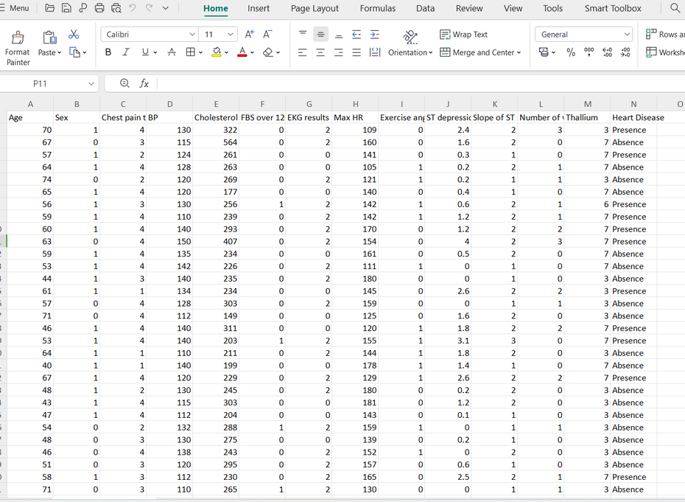
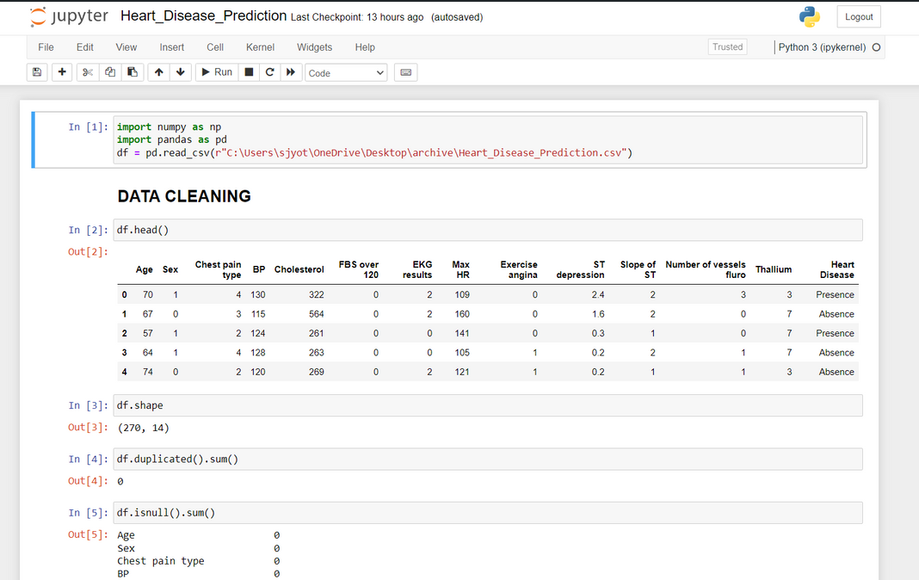
IMPORTING THE DATASET-:
Heart Disease Dataset view in excel format
Importing the Heart Disease Dataset in Jupyter Notebook

Slide 5
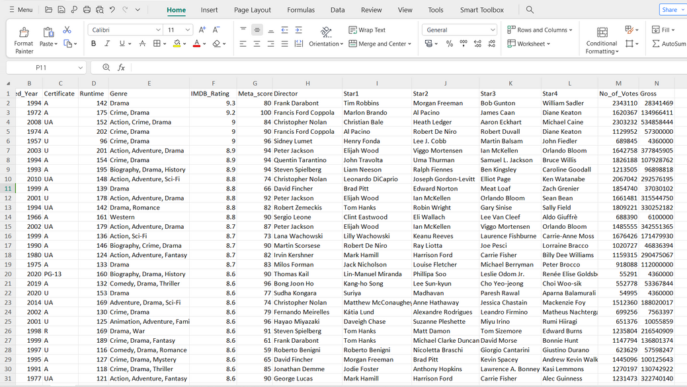
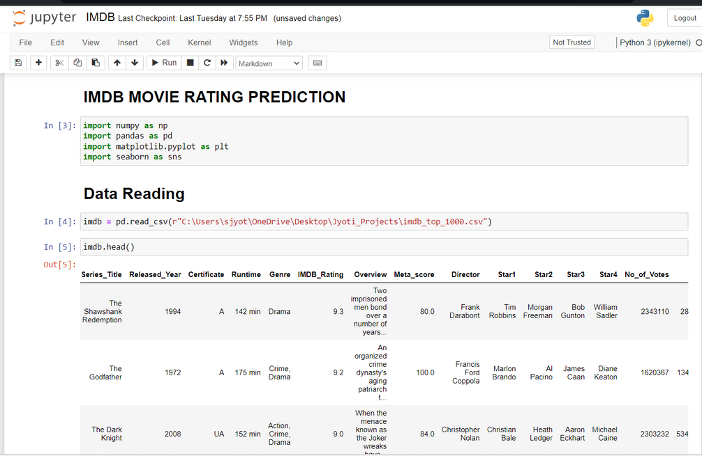
IMPORTING THE DATASET-:
IMDB Dataset view in excel format
Importing the IMDB Dataset in Jupyter Notebook

Slide 6
DATA CLEANING-:
Data Cleaning Steps:
data reading(for ".data" and ".csv" extension write "pd.read_csv" and for ".xlsx" extensionwrite "pd.read_excel")
renaming columns(if required)
check null values or missing values ( var.isnull().sum() )
check data types ( var.dtypes )
check unique values of each column
print describe and use the values from it to replace whereever you find problems in anyattribute or column of dataset
change datatype after replacing if required
Matplotlib and Seaborn

Slide 7
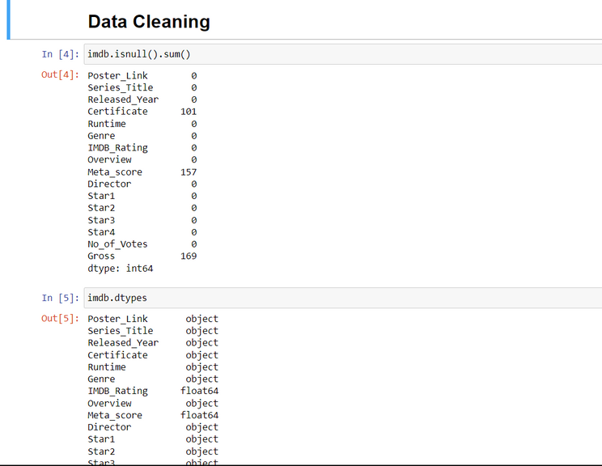
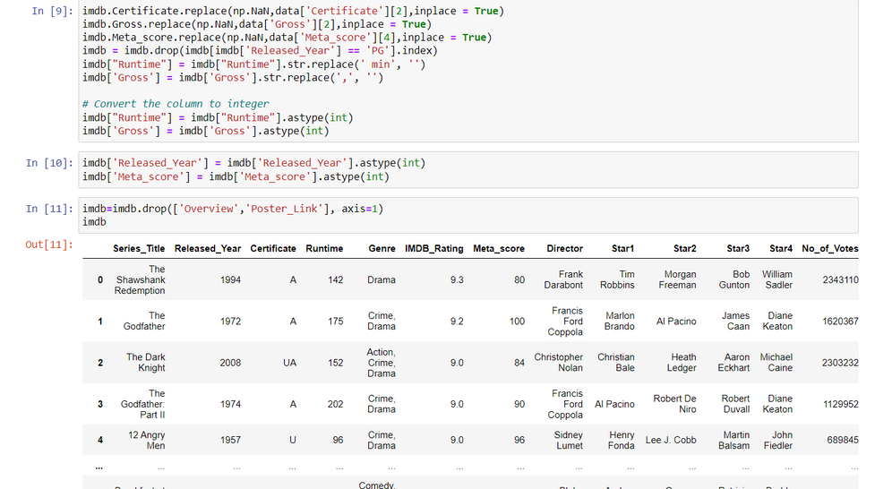
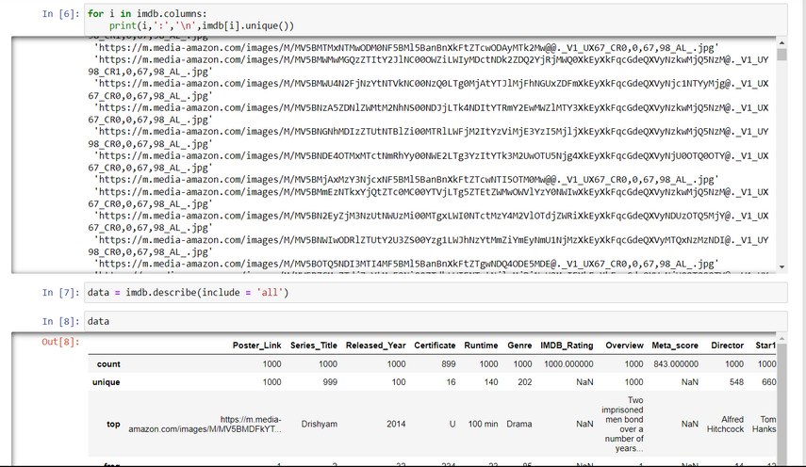
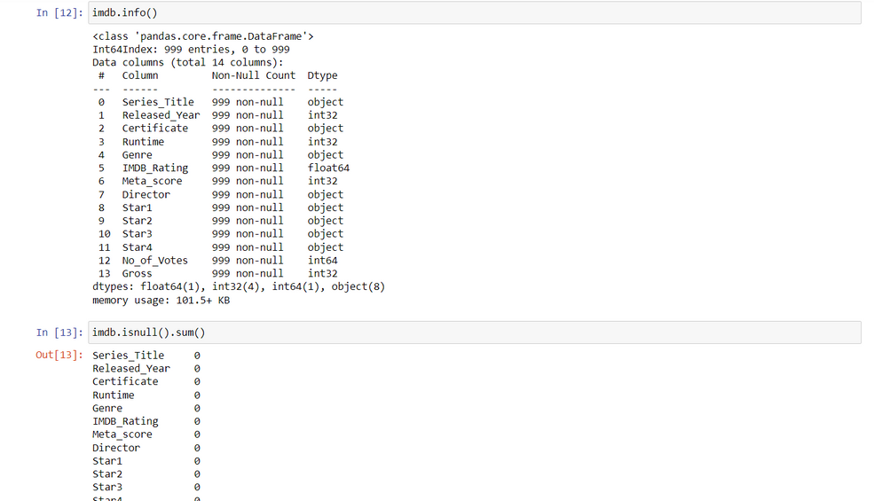
DATA CLEANING IN JUPYTER NOTEBOOK

Slide 8
DATA VISUALIZATION-:
Libraries like Matplotlib and Seaborn are used in this process.
Matplotlib steps-:
Import the library: import matplotlib.pyplot as plt
Create data to be visualized.
Use plotting functions like plt.plot(), plt.scatter(), plt.bar(), etc.
Customize the plot with titles, labels, and legends.
Display the plot using plt.show().
Seaborn steps-:
Import the library: import seaborn as sns
Create data to be visualized.
Use Seaborn functions like sns.lineplot(), sns.barplot(), sns.heatmap(), etc.
Customize the plot as needed.
Display the plot using Matplotlib’s plt.show()

Slide 9
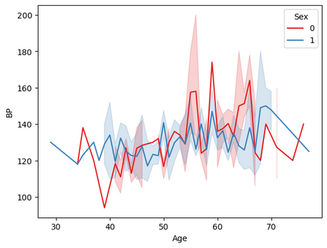
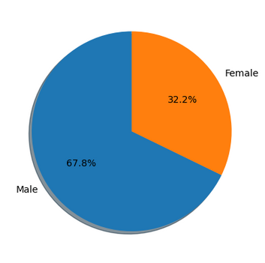
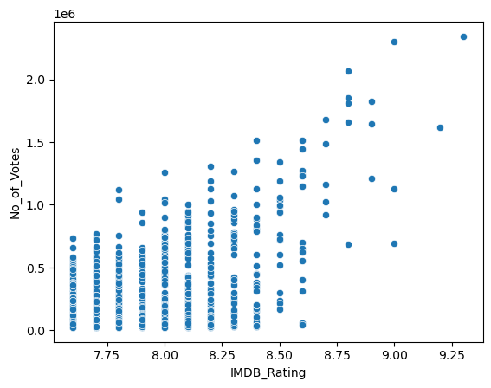
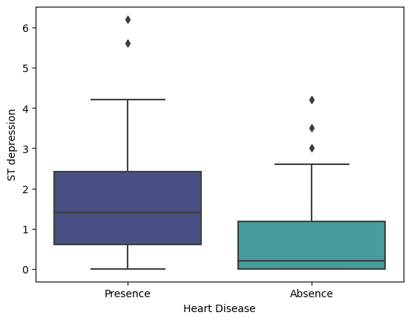
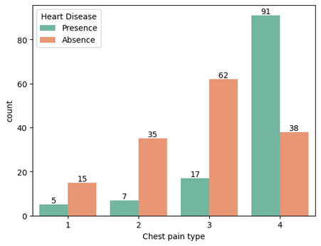
DATA VISUALISATION IN JUPYTER NOTEBOOK
Line plot
Pie Chart
Bar plot
Scatter plot
Box plot

Slide 10
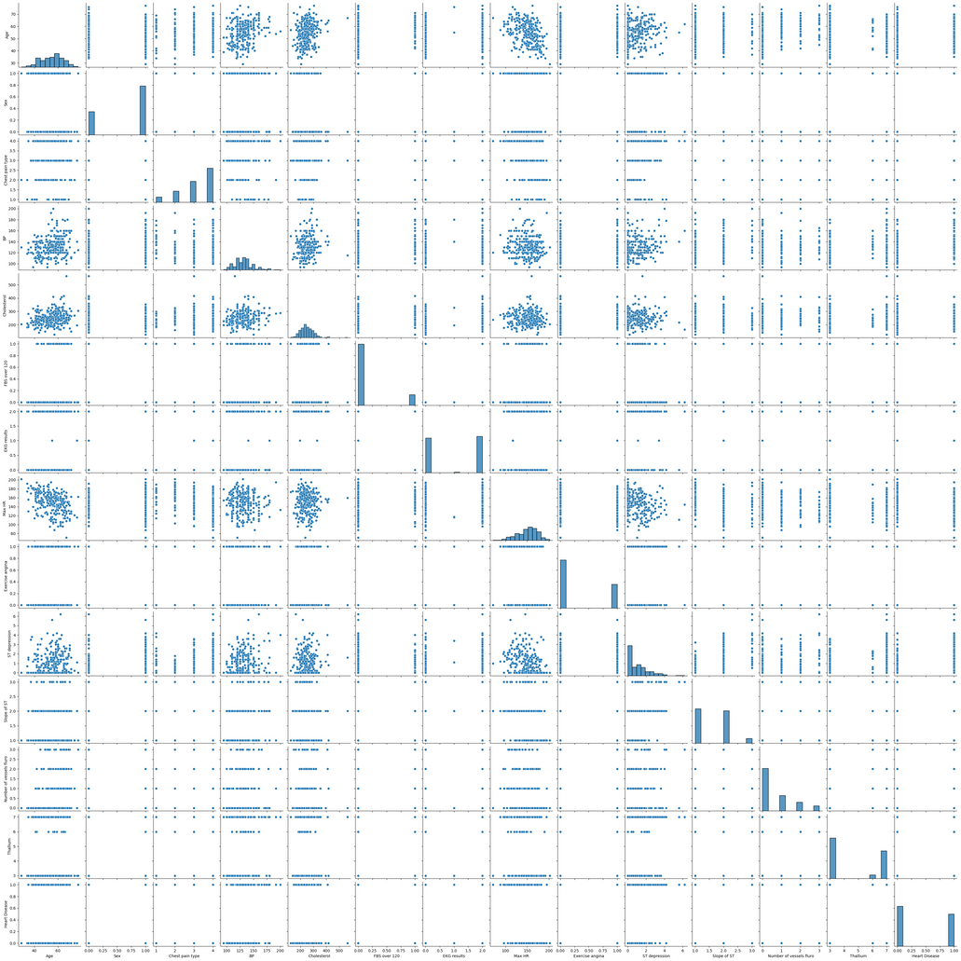
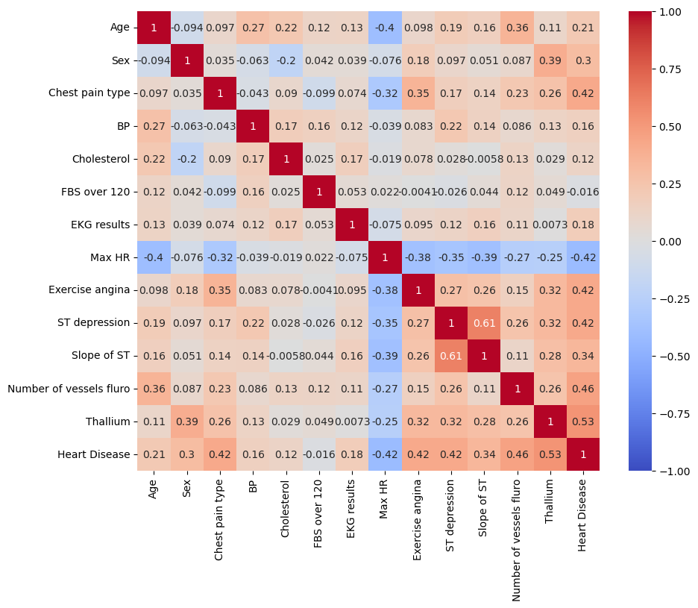
CONTD..
PAIR PLOT AND HEATMAP
Pair-plot
Heatmap

Slide 11
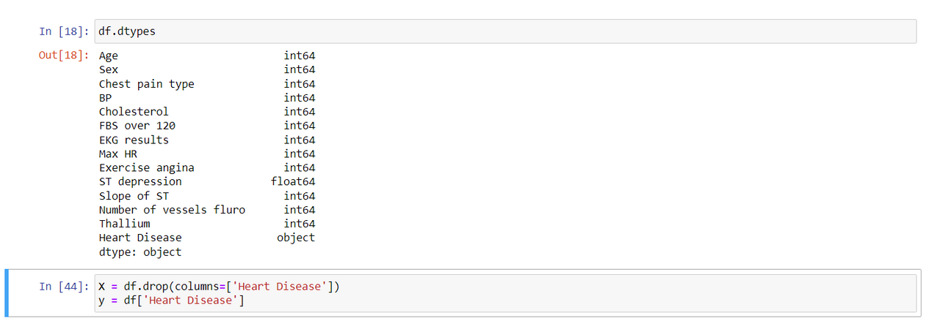
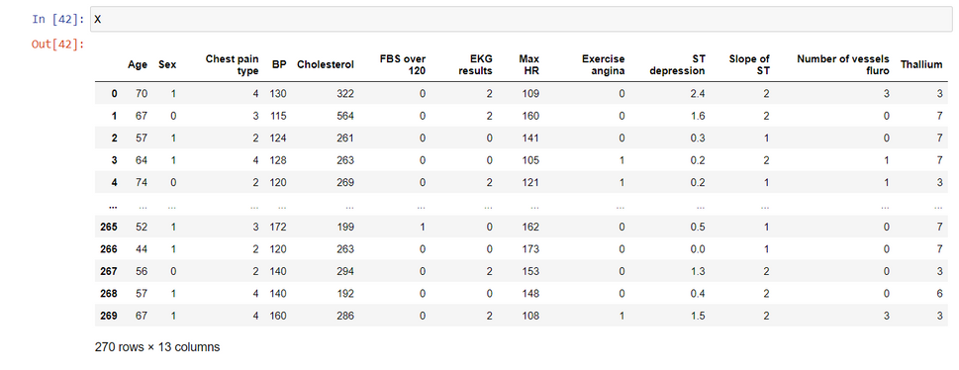
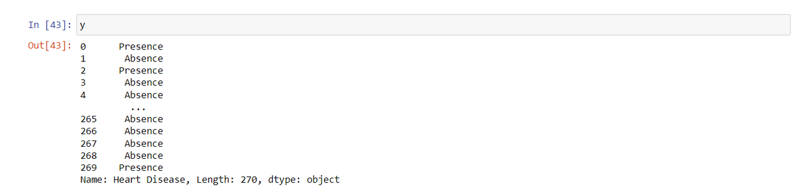
DIVIDING THE DATASET INTO INPUT AND OUTPUT FOR PREDICTION
As there is a categorial column Heart Disease which have only two unique values i.e. either true or false so we have considered the column Heart Disease as the Output Column and all other columns as input columns.
These are all my columns with their respective datatypes
Input Columns
Output Columns

Slide 12
SELECTING MODEL-CLASSIFICATION/REGRESSION
As our Output Column is Categorical So we have to use Classifier models
So Some of the Classifier techniques are -:
Logistic Regression
Gaussian Naive Bayes (GNB)
Support Vector Regression (SVR)
K-Nearest Neighbors (KNN)

Slide 13
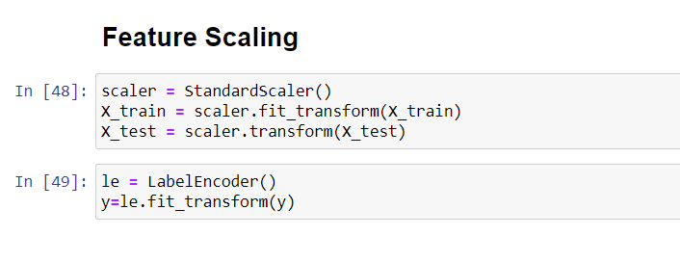
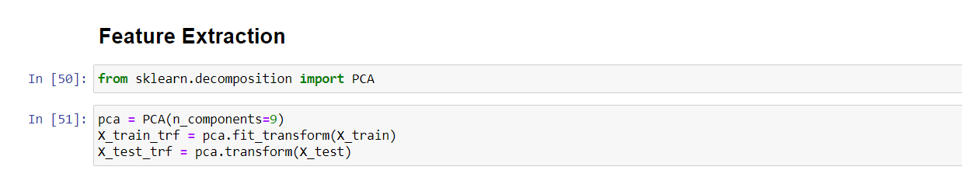
STANDARD SCALER AND PCA
(GETTING THE DATASET READY FOR CLASSIFICATION)
StandardScaler is used to standardize features by removing the mean and scaling to unit variance, ensuring each feature contributes equally to the model
Principal Component Analysis (PCA) is a dimensionality reduction technique that transforms data into a set of orthogonal components, capturing the most variance. It simplifies complex datasets while preserving essential information.

Slide 14
CALCULATING R2 SCORE AND MEAN SQUARED ERROR-:
R² Score: The R² score, or coefficient of determination, measures how well the regression predictions approximate the real data points, indicating the proportion of the variance in the dependent variable explained by the independent variables.
Mean Squared Error (MSE): Mean Squared Error quantifies the average squared difference between the observed actual outcomes and the predicted values, serving as a measure of the quality of an estimator.

Slide 15
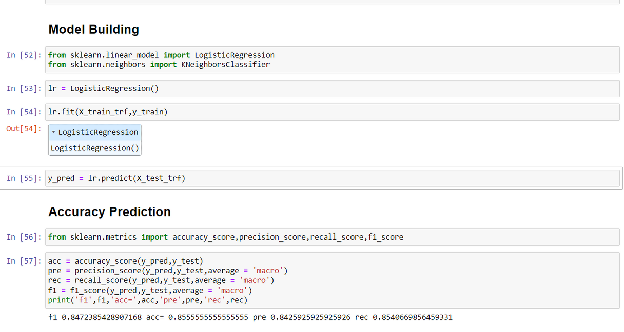
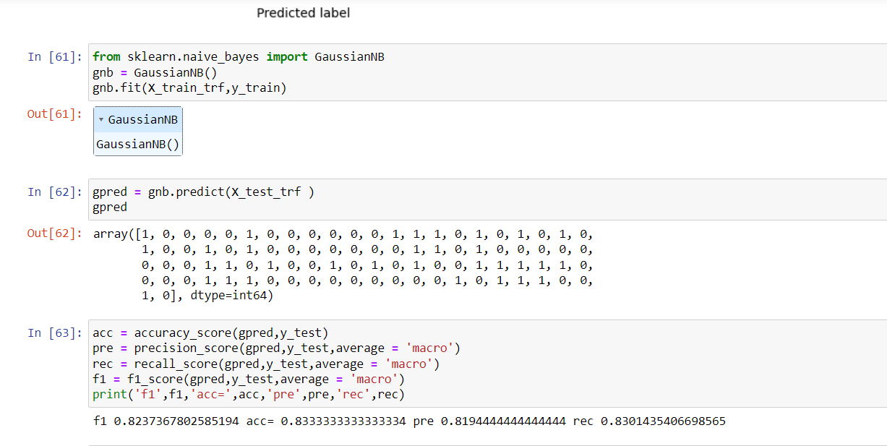
Logistic Regression and Gaussian Naive Bayes (GNB)
LOGISTIC REGRESSION
Gaussian Naive Bayes (GNB)

Slide 16
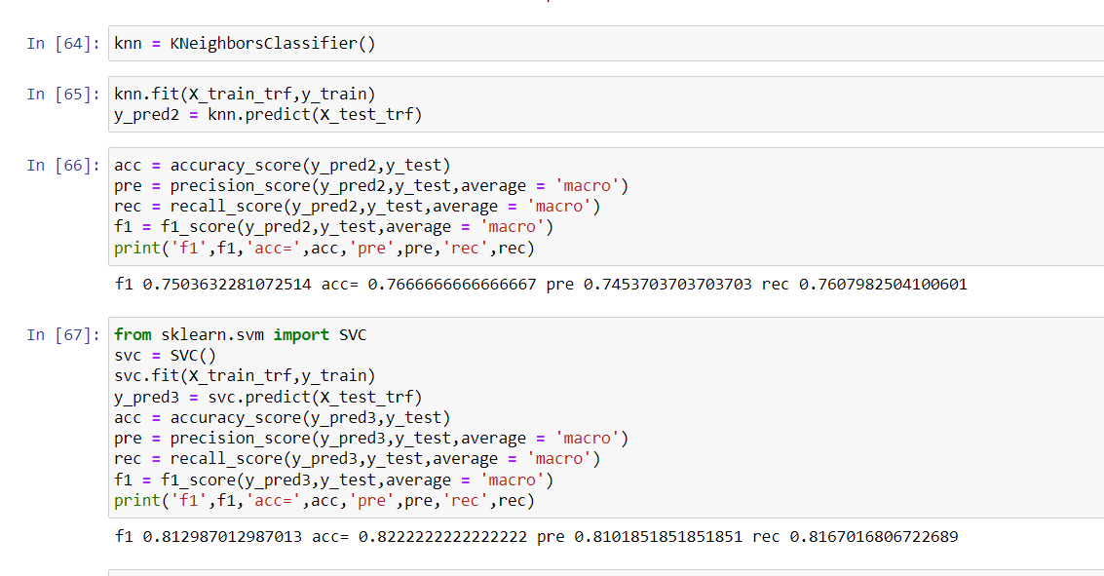
K-Nearest Neighbours (KNN) and Support Vector Regression (SVR)

Slide 17
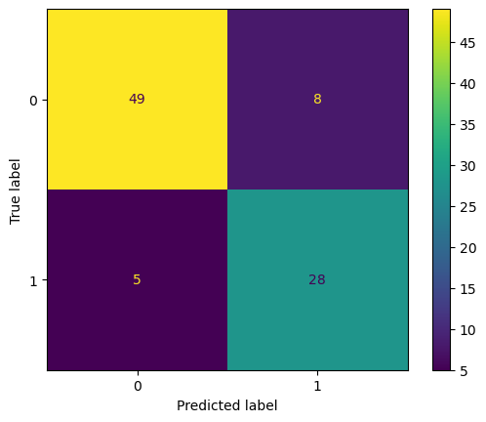
A confusion matrix is a table used to evaluate the performance of a classification algorithm, displaying the counts of true positives, true negatives, false positives, and false negatives. It provides insight into the accuracy and errors of the model across different classes.

Slide 18
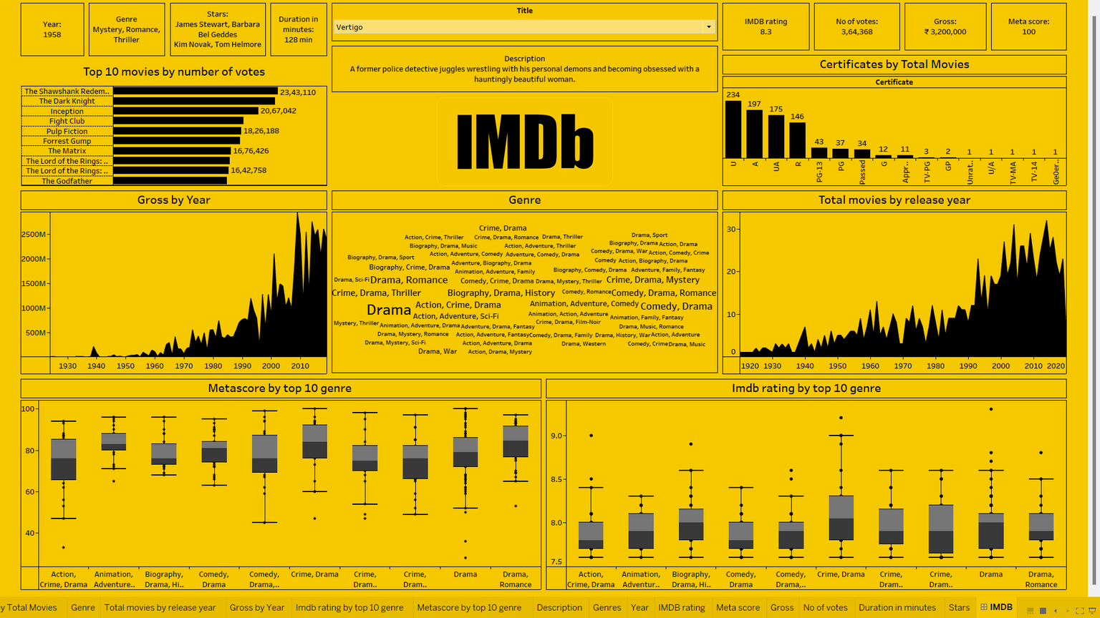
TABLEU DASHBOARD

Slide 19
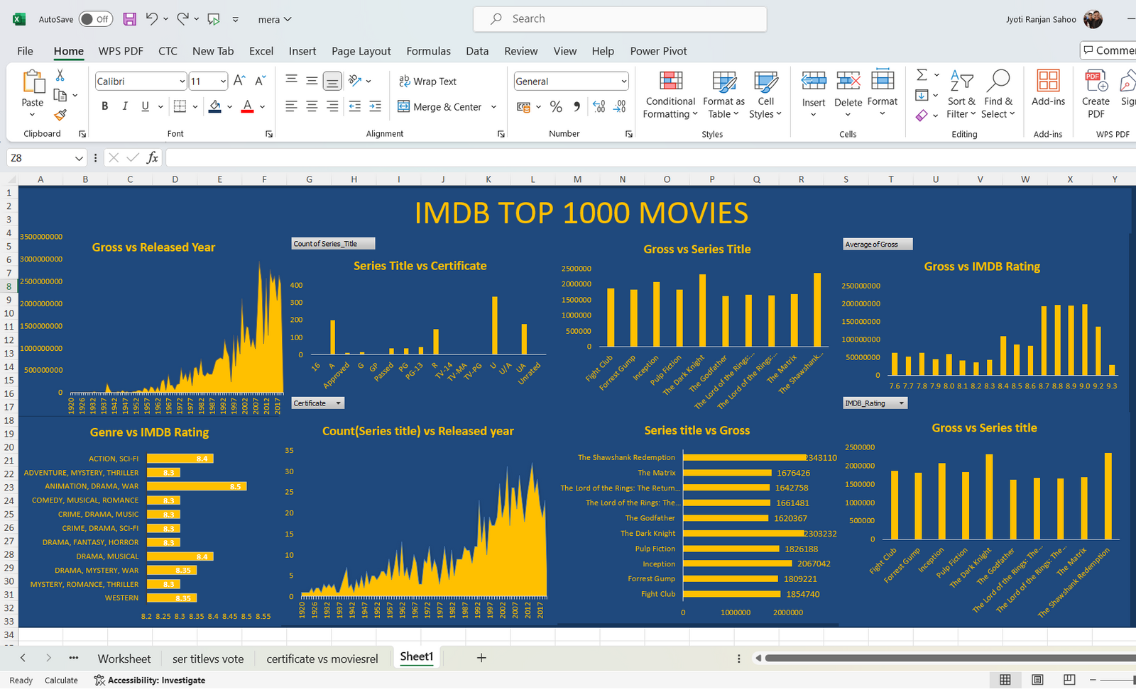
EXCEL DASHBOARD

Slide 20
CONCLUSION-:
We have tried several techniques but the best performance is given by Logistic Regression with a f1 score of 0.84 , accuracy score of 0.85 , precision score of 0.84 and recall score of 0.85
We have also created interactive dashboards in Excel and Tableu for better data analysis and Visualisation.

